Slide 1
The Videos
As with previous checkpoints in the term, you will make a 6-minute (max, shorter is fine) video.
Note that we will reorganize the groups so that people get to see as many as possible of the
projects. As a result you’ll need to spend just a little more time explaining the project. Outline:
• What is the system supposed to do? (~30 seconds, for people who haven’t seen it before)
• Focus on an impressive demo with a real example of input and the system’s response.
• Describe how it works. Note that this should be at the conceptual and architectural level,
not at the level of code. Describe what the major ideas, techniques, and tools you used.
• Describe how well it works. What did it do well and what did it do badly? What scope of
performance did you get, i.e., what can it do beyond the example that you gave?
• Provide an example of an interesting failure. This issue is very important – we all learn a
lot from knowing where the frontiers are. This can be an example within the current
scope that doesn’t work for an interesting reason, or an example that’s just beyond the
current scope and doesn’t work for an interesting reason. This is sometimes difficult to
answer, so be prepared to put in some time on this question.

Slide 2
SmartSlides
Gaby Ecanow, Marlena Gomez, Gila Schein
Notes:
Gila:
Smart Slides is a handsfree, multi-modal system for dynamically controlling slideshow presentations. Let’s walk through SmartSlides behind the scenes…

Slide 3
• What is the system supposed to do? (~30 seconds, for people who haven’t seen it before)

Slide 4
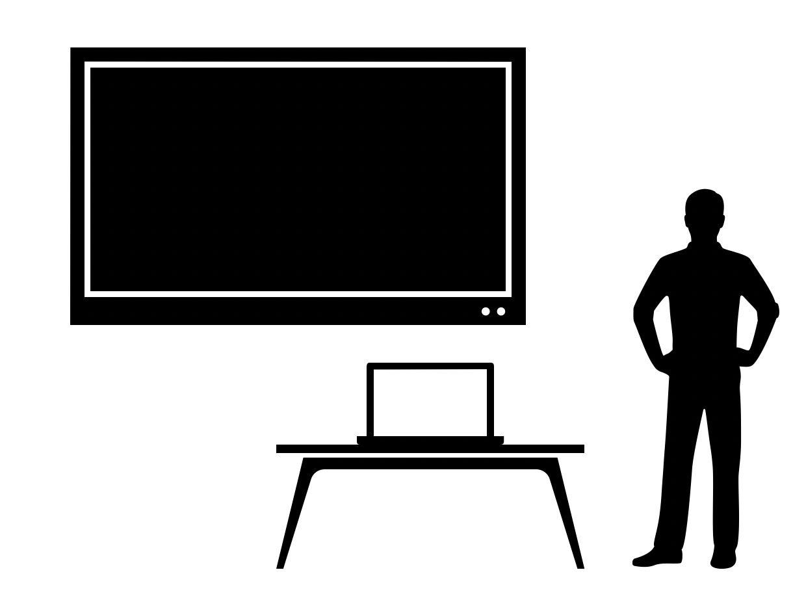
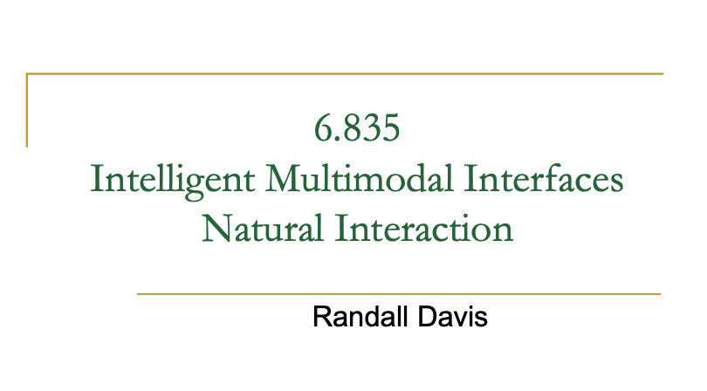
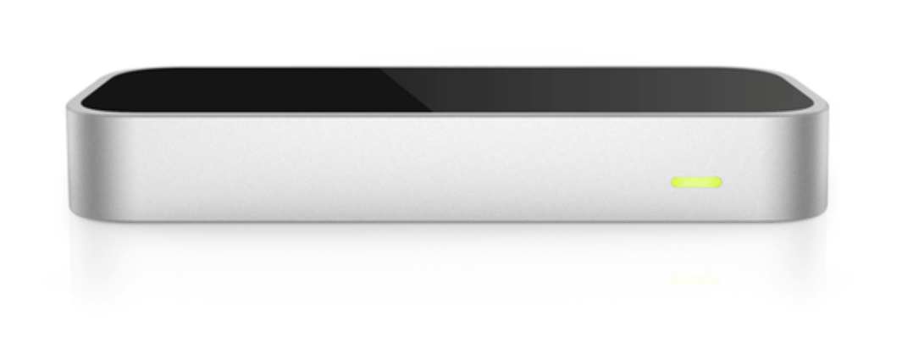
System Overview
Notes:
With today’s technology, we should not need to twist our arms to use a laser pointer or escape presentation mode to add highlights, circles, or other on-the-fly interactions. Smart Slides integrates live motion and voice tracking to make you forget about these pain points, all while enhancing the presentation experience. With Smart Slides, a speaker will be able to consistently face their audience while smoothly navigating a dynamic presentation in the spotlight.

Slide 5
• Describe how it works. Note that this should be at the conceptual and architectural level,
not at the level of code. Describe what the major ideas, techniques, and tools you used.

Slide 6
Architecture Diagram
Inputs
Presentation & customizations
Speech Input
Gesture Input
Web Kit Speech Recognition
Leap Motion Gesture Toolkit
Multimodal Interface
UI Changes to Presentation
Output
Notes:
Our system takes three inputs - speech, gesture, and presentation slides and customizations.
Upon loading our system, a user will be prompted to select their presentation from their computer. After confirming the presentation on our system browser, the user will be prompted to incorporate any additional customizations it may want for the purpose of their specific slide deck. Then, the user can view the instructions and say the “start” command to begin presentation mode.
During the live presentation, we’ll read the raw speech and motion input, which we’ll pass into separate toolkits for preprocessing. For speech, we used the Web Kit Speech Recognition software, which recorded speech and returned a transcript to be analyzed for our uses.
For gestures, we used the Leap Motion Gesture Toolkit. We chose the Leap firstly for its compactness and versatility, which could contribute to wide use. For example, each classroom at a university could be equipped with a Leap, similar to how most classrooms already have HDMI adapters. In addition, Leap comes with an extensive library of recorded recognized gestures and does not require additional training. Lastly, because the Leap only records local hand gestures, users will not feel the extra burden of having full pose recordings or RGB video captured during their presentations.
After preprocessing, we plan to evaluate the gestures and transcripts in a model which outputs a concrete SmartSlides command. Using this command, we make the appropriate changes to the presentation to dynamically update the slides in real time.

Slide 7
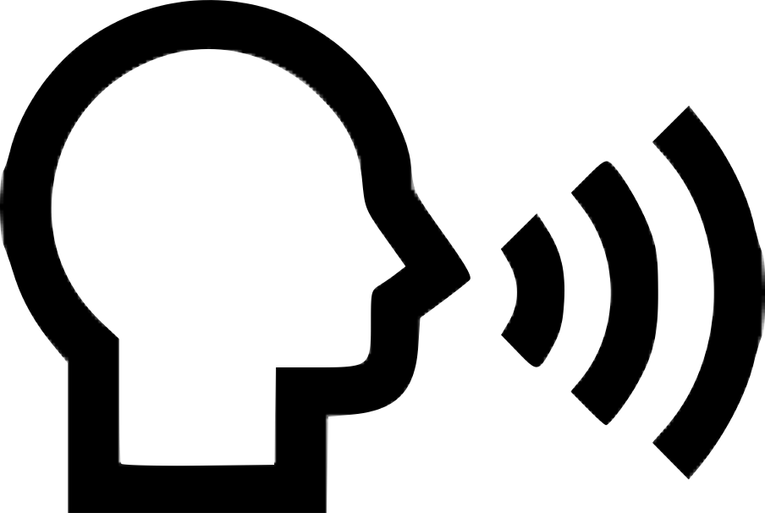

System Inputs
Speech Commands
Cue a laser pointer
Slide navigation
Next, previous, specific slide numbers
Undo the last drawing (highlight, circle, text box)
Speech & Gesture Commands
Control laser pointer
Create a circle
Highlight text
Insert text box
Gesture Commands
Swipe with right/left hands to navigate slides forward and backwards
Notes:
As mentioned, SmartSlides considers a series of speech commands, gesture commands, and commands which involve both inputs.
Using speech, presenters can start presentation mode, turn on a laser pointer, and navigate between slides across the whole slide deck. With gestures only, because of the level of accuracy in the Leap Motion Gesture Toolkit, we chose to use specific gestures only to control navigation to the next and previous slide. However, general hand positioning combined with specific speech commands also control the movement of the laser pointer, creation of circles with customizable size and color, allow for text highlighting in multiple colors, and allow the user to dynamically add text on-the-fly to a slide in a specific location. After making an addition like a circle, highlight, or text box to a slide, if the user wants to undo this they can do so with the speech command “undo.”
All of the gesture and speech commands are described in a help page which can be displayed in the webserver by pressing the ‘h’ key on the keyboard.

Slide 8
Project Roadmap
Initial speech and gesture implementation
Added text box, undo and “jump to slide X”features
Integration of presentations
User studies & feedback
User studies & feedback
Addition of highlight and circle controls
Revamping of highlight and circle
New UI and custom speech and gesture commands
User studies & feedback
Notes:
Before we show our demonstration, here’s a quick roadmap of the progress of our project:
In the implementation studio, we had manually incorporated the exported html script of a presentation into our code file. Now, a user can follow commands upon starting the program to upload their saved presentations directly in powerpoint or keynote form. Google Slides presentations can be saved as a powerpoint and work seamlessly with our system as well.
In addition, we have fine tuned our current speech and gesture commands to expand customizability across the circle and highlight commands, and we added a new feature to dynamically add text onto a slide to label items, write notes from scratch, or supplement the displayed material.
Finally, in order to maximize user customization, we prompt the user before starting the presentation to include any additional speech and/or gesture commands from a list of compatible options. This expands the proposed reach of our project and gives more control to the user.
Now, let’s watch our current end-to-end system in action!

Slide 9
• Focus on an impressive demo with a real example of input and the system’s response.

Slide 10

System Demonstration

Slide 11
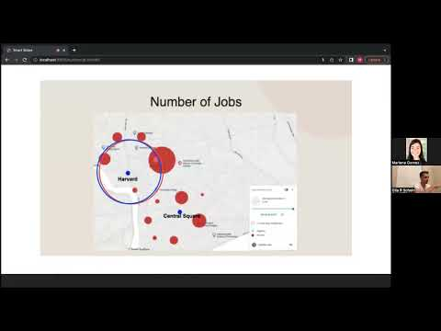
User Demonstration
Notes:
https://youtu.be/oqN8-QDztRM

Slide 12
• Describe how well it works. What did it do well and what did it do badly? What scope of
performance did you get, i.e., what can it do beyond the example that you gave?

Slide 13
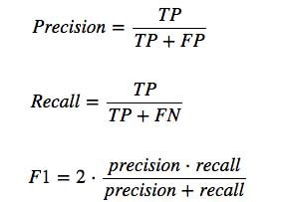
Quantitative Evaluation
True positive (TP): correctly identifying an intentional gesture or speech command
False positive (FP): identifying unintentional speech or gesture command
False negative (FN): incorrectly identifying an intentional gesture or command
Notes:
In order to evaluate our system, we use both quantitative and qualitative evaluation metrics. In terms of a quantitative metric, we use precision, recall, and F1 accuracy formulas as learned in class. These formulas consider true positives, false positives, and false negatives as defined in the slide.

Slide 14
 | gesture commands |  | speech commands
 | right hand swipe right | left hand swipe left | laser | highlight | circle | text box | next | previous
1 | TP | FN | TP | TP | TP | TP | TP | TP
2 | TP | TP | TP | TP | TP | TP | FN | TP
3 | TP | TP | FN | TP | TP | TP | TP | TP
4 | TP | TP | TP | TP | TP | TP | TP | TP
5 | TP | TP | TP | FN | TP | TP | FN | TP
6 | TP | FN | TP | FN | TP | TP | TP | TP
7 | FN | TP | TP | TP | TP | TP | TP | TP
8 | FN | FN | TP | TP | TP | TP | TP | TP
9 | TP | FN | TP | TP | TP | FN | FN | TP
10 | TP | FN | TP | TP | TP | TP | FN | TP
11 | TP | FN | TP | TP | TP | FN | TP | TP
12 | TP | FN | FN | TP | TP | TP | TP | TP
13 | TP | TP | TP | TP | TP | TP | TP | TP
14 | TP | TP | TP | TP | TP | FN | TP | TP
15 | TP | TP | TP | TP | TP | TP | FN | TP
16 | TP | FN | TP | TP | TP | FN | TP | TP
17 | FN | TP | TP | TP | TP | TP | TP | TP
18 | TP | TP | TP | TP | TP | TP | TP | TP
19 | TP | FN | TP | TP | TP | FN | TP | TP
20 | TP | TP | TP | FN | TP | TP | TP | TP
Notes:
We ran a series of tests on our gesture and speech commands across multiple people to gather data in order to simulate measurements of accuracy for our system.

Slide 15
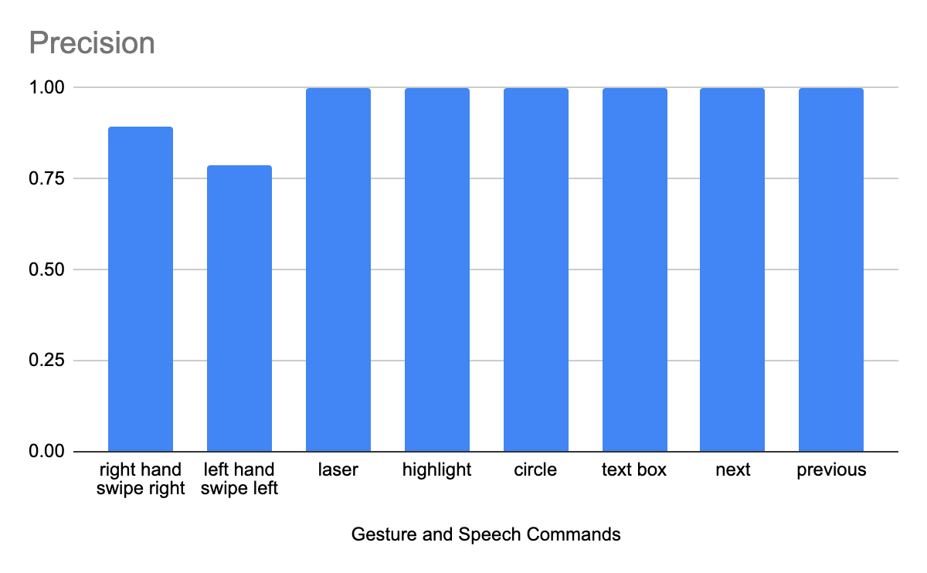
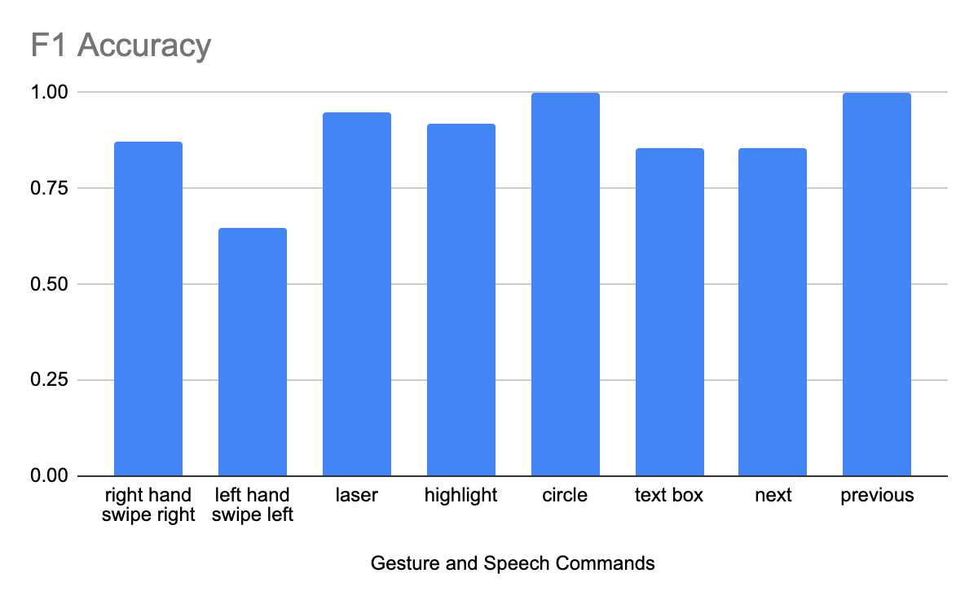
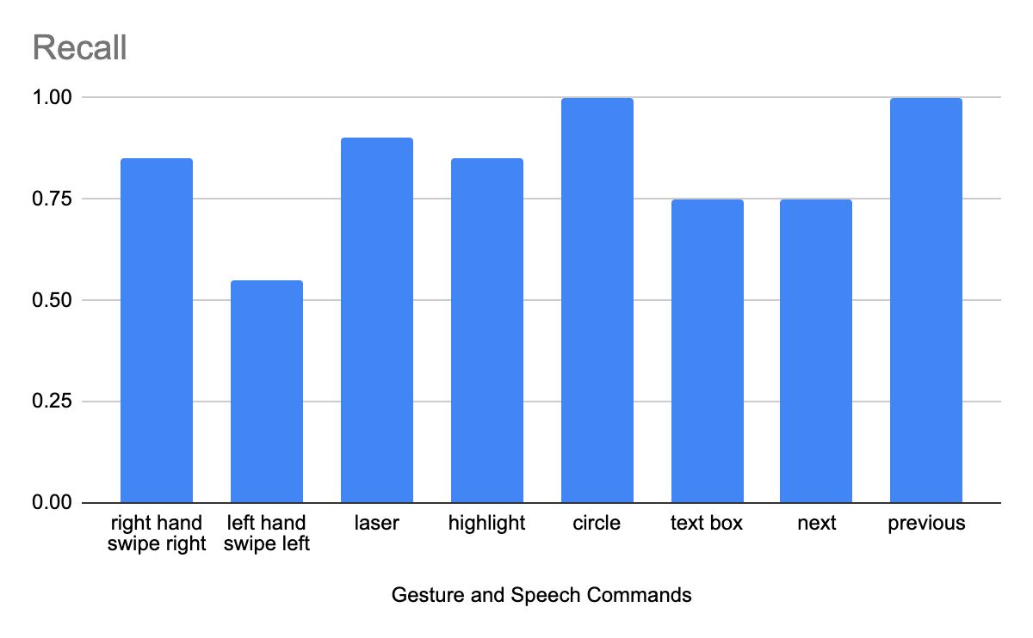
Quantitative Evaluation
Notes:
Here are three charts we created from our data testing. The top left measures precision, bottom left recall, and the right side, which holds the most weight for us as it takes into account both precision and recall, is the F1 accuracy calculation. Each gesture and speech command corresponds to an accuracy score on the y-axis from 0 to 1. In the charts, you can see a common trend where the gestures have lower values than the speech commands.

Slide 16
Qualitative Evaluation
“This would be great in a lecture hall, so I wouldn’t have to turn around during my presentation.”
“As a TA of a class, it would be super helpful especially when I have students over zoom so I don’t have to exit out of my slideshow, reshare my screen, and disrupt the whole presentation process.”
“Gestures and commands were both easy and intuitive.”
“Both my parents are professors and I think it would be a very useful tool for them.
“The voice commands work really well,
but the gestures are okay.”
“I had some trouble with the circle gestures.”
Notes:
We were able to gather very useful feedback to better improve our system - both positive and negative - through qualitative evaluation from our users. On this slide, we highlight a few key points from our series of user studies. Our users also noticed the distinct difference in accuracy between the voice commands and gesture commands. Overall, the users appreciated the idea and implementation very much!
However, our implementation plan included quite a few roadblocks - one significant and interesting one was the integration of slideshow presentations…

Slide 17
What Did It Do Well
What Did It Do Badly
Speech recognition
Slide integration UI
Intuitive customization page
Text insertion
Live transcript
Gesture recognition
Increasing lag over time
Cannot integrate embedded videos through Keynote
Notes:
In summary, here are a few things that worked well
- speech recognition, especially for “previous” and “circle”
- slide integration user interface, simple and step-by-step all inclusive
- the customization page proved to be quite intuitive in user studies
- the ability to insert text on a slide during a presentation
- the “speech debug” feature we originally used primarily for debugging served to be useful for transcribing the presentation through live captioning
And here are a few things that did not
- Gesture recognition, especially for the left hand
- The lag increased over time throughout the presentation
- Keynote’s feature to convert presentations to html format does not currently support embedded videos, so we are limited to using presentations without videos (which unfortunately does not include this one)
Scope of Performance -

Slide 18
Scope of Performance
Additional Features
“forward X slides” or “back X slides”
Multi-color highlight opt
Additional Applications
Multi-person zoom presentations
Whiteboard use
Notes:
We mentioned and demonstrated many of our system’s features already. A

Slide 19
• Provide an example of an interesting failure. This issue is very important – we all learn a
lot from knowing where the frontiers are. This can be an example within the current
scope that doesn’t work for an interesting reason, or an example that’s just beyond the
current scope and doesn’t work for an interesting reason. This is sometimes difficult to answer, so be prepared to put in some time on this question.

Slide 20
Slides Integration
An Interesting Failure
Notes:
It turns out, using proprietary slides software is not as simple as it seems! We tried a lot of ways to integrate directly with Google Slides, but ended up finding that Keynote’s export-to-HTML feature was the best way forward.
Even still, Apple did not make parsing the HTML and associated javascript easy. The javascript file powering the entire presentation was exported all on a single line, and variable names were not easy to parse. However, after a lot of poking around, we finally found and figured out how to directly call and manipulate the presentation controls ourselves.
However, even after pivoting and figuring out the implementation side of things, we realized that users had trouble actually getting set up with their presentation. It was extremely unintuitive for users to manually export their presentations to HTML and then integrate the returned assets into our project. To make this process easy and intuitive for users, we had to learn Apple scripting and wrote an AppleScript to handle finding a powerpoint or keynote presentation, exporting it to HTML, and loading it into the project folder. This lightweight app actually lives in our project folder, so now, to get started, all users need to do it double click on it on our SmartSlidesBegin application as was seen in the video.
Even though it was an extremely long process, it ended up advancing our project because we could use functions to control to the slideshow directly.

Slide 21



Slides Integration
SmartSlides
S
S
Notes:
Gila:
To integrate a slides presentation, we automatically convert it to a powerpoint using the Slides API, and then convert that to HTML, which we can then embed directly in our site. As we’ll discuss more later, it’s surprisingly impossible to go directly from slides to fully-manipulatable HTML, which is why we go through powerpoint.

Slide 22
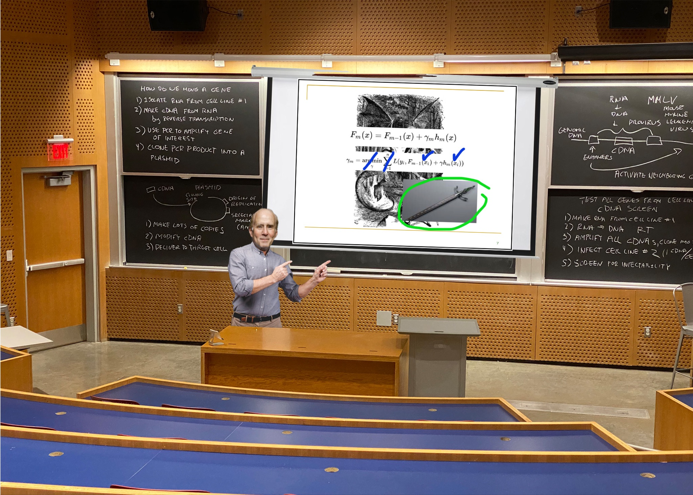

That side of the room, what is this?!
Notes:
Thank you for listening. We’re excited to field questions and receive feedback.

